Slide 1
Beautiful Quotes in Minutes
Table of Contents
Instructions: Step 1 – Choose Quote & Image
Instructions: Step 2 – Design Quote
Instructions: Step 3 – Export Slide as PNG
Quote Templates (select below)
About SavFaire Solutions

Slide 2
Instructions 1/3
Step 1: Choose Quote & Image
Quote:
Understand Your Why🤔 - Determine the purpose of the quote: to evoke emotion, add credibility, or inspire reflection.
Choose Relevant Quotes 🎯 - Select a quote that is timely, relevant, and reflects your brand’s values.
Verify Quote and Author 🔍 - Research the quote and its author to ensure they align with your personal or brand image.
Adhere to Copyright Rules ©️ - Respect copyright and attribution conventions when using quotes.
Image:
Choose a Concept🖼️- Using your why from above, think about an image concept that supports this why. It could be a feeling, a topic, or an art style.
Choose an Image 💕- Find an image in PPT Stock you like that has no focal point (nothing in the center) or,
Create an Image (CoPilot) 🖌️ and create an image yourself. Ensure your prompt includes the art style (abstract) and the context (background image)

Slide 3
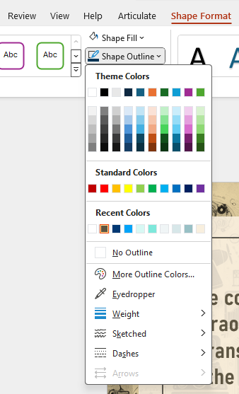
Instructions 2/3
Step 1: Design Quote
1) Adjust quote & author text to your use-case
2) Keep existing photo or select Picture Format, change picture, and then pick a picture off your device or stock images
3) Select Shape Format, Shape Outline, and Eyedropper. Choose a dark color for clear contrast and easy reading.
4) Consider adding your company logo when appropriate
1
2
3
1
2
3

Slide 4
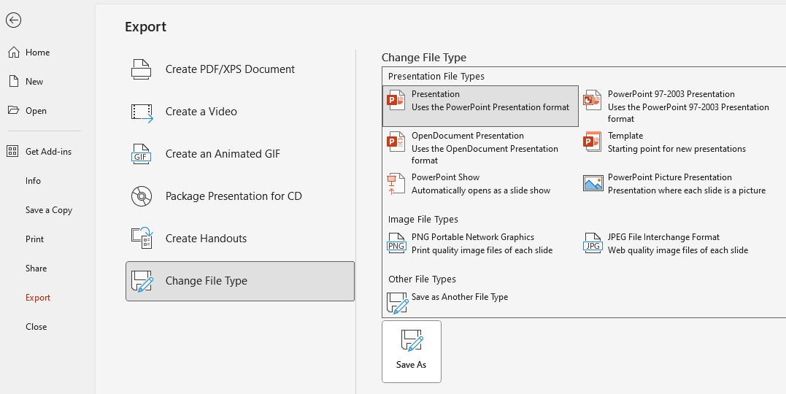
Instructions 3/3
Step 3: Export Slide as PNG
Select File, Export, Change File Type, select PNG Portable Network Graphic, and then Save As
Select “Just this One” and title appropriately
3) Your image is ready to use
3
1
2
4
1

Slide 5
AI
The consequences will be extraordinary and possibly as transformational as some of the major technological inventions of the past several hundred years.
Jamie Dimon

Slide 6
The most important investment you can make is in yourself
Warren Buffet

Slide 7
The stock market is filled with individuals who know the price of everything, but the value of nothing.
- Phillip Fisher

Slide 8
Habit will not fail under pressure
- Tim Koegel

Slide 9
In baseball and in business, there are three types of people. Those who make it happen, those who watch it happen, and those who wonder what happened.
- Tommy Lasorda

Slide 10
Change is inevitable. Growth is optional.
- John C. Maxwell

Slide 11
About SavFaire Solutions
At SavFaire Solutions, we help technical experts communicate their hard-earned expertise at scale through communication & training solutions. Hire us for a ready-to-go workshop or work with us to co-create & facilitate custom solutions.
Email: Erika@savfairesolutions.com
Phone: 970-691-8479
Website: https://savfairesolutions.com

